Slide 1

AI23431 - WEBTECHNOLOGY AND MOBILE APPLICATION PROJECT REVIEW
BOOK SHARING AND EXCHANGE PLATFORM (BSEP)
Presented by :
JEEVAVENI S (241501076)
KIRUBASHINI R (241501087)

Slide 2

Introduction
BSEP is a web-based platform enabling users to share, exchange, and discover books within their community.
Supports book listing, search, and user-to-user exchange with rating and review system.

Slide 3
Problem Statement
Buying books is expensive; many books are read once and left unused on shelves.
Need for an accessible, community-driven platform to share and exchange books affordably.

Slide 4
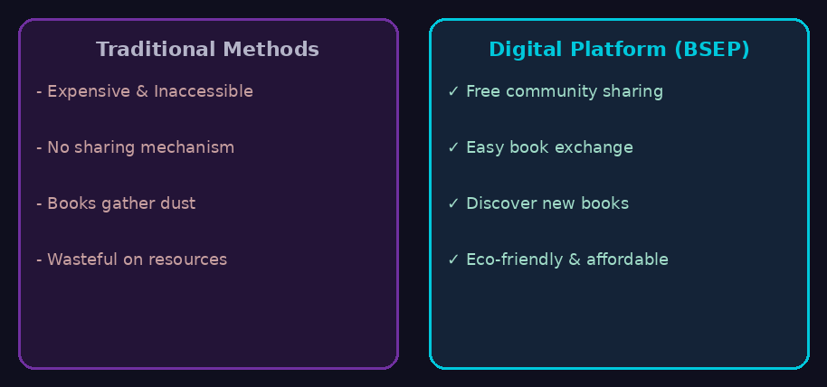
Objectives
Enable book listing and discovery
Secure user authentication
Book exchange request system
User ratings and reviews
Community-based sharing network

Slide 5
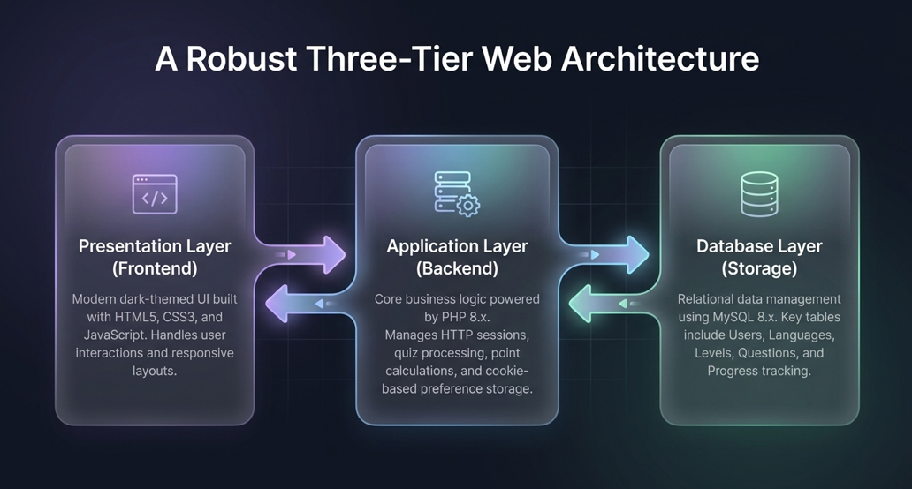
System Architecture

Slide 6
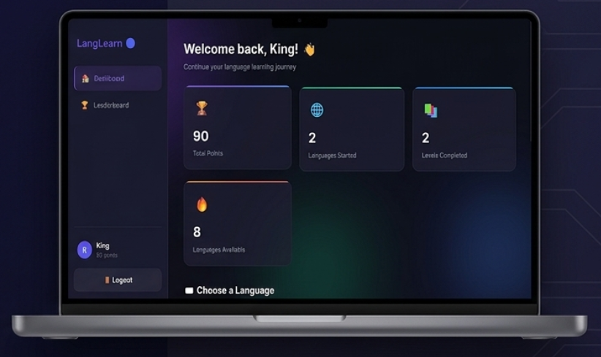
Key System Characteristics
User-friendly book browsing UI
Secure login & sessions
Real-time exchange requests
Scalable book database

Slide 7
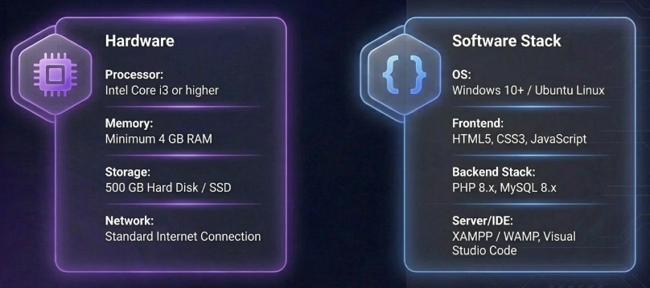
Hardware & Software Requirements

Slide 8
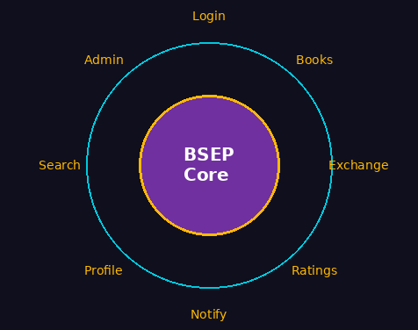
System Modules
Modules of the System
Login & Registration
User Profile & Dashboard
Book Listing & Search
Book Categories & Filters
Exchange Request Management
Ratings & Reviews
Notifications & Alerts
Admin Panel

Slide 9
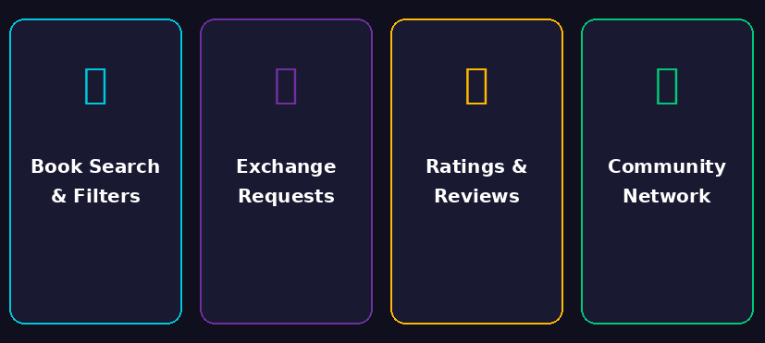
Key Features
Book search & filters
Exchange request system
User ratings & reviews
Community sharing network

Slide 10
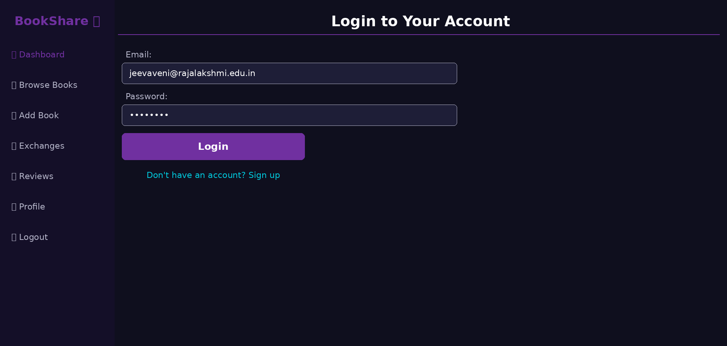

Slide 11
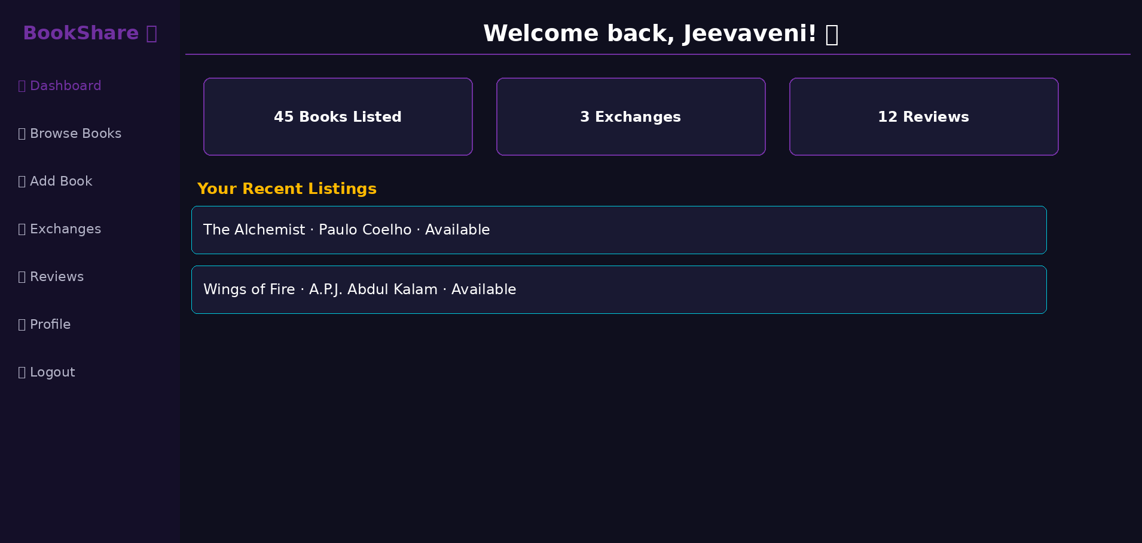
System Screenshots

Slide 12
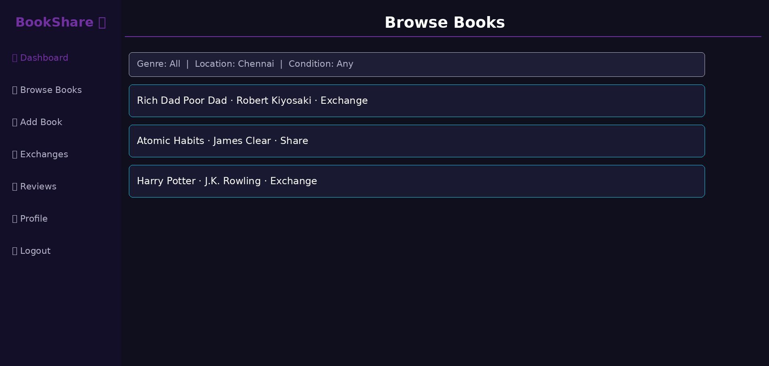

Slide 13
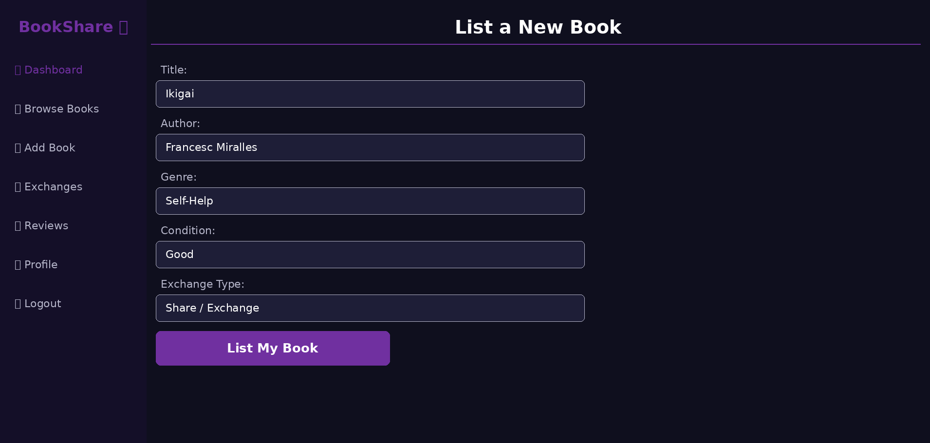

Slide 14
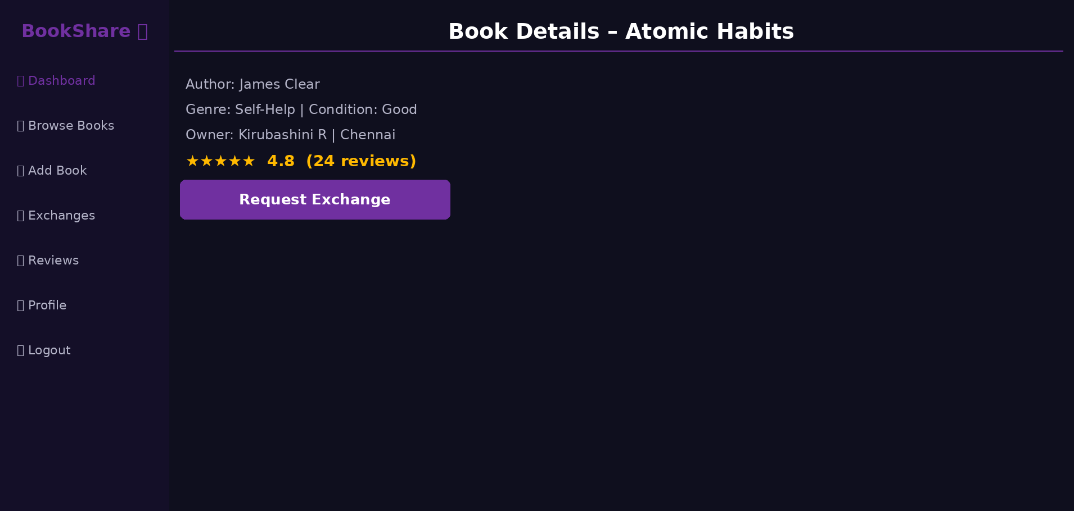

Slide 15
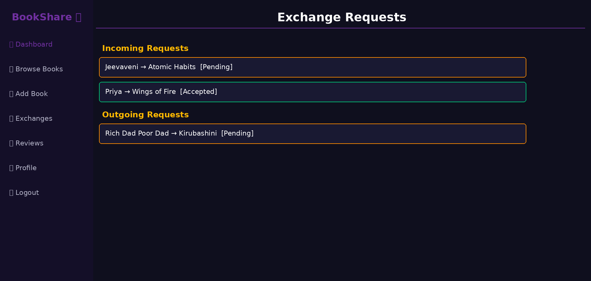

Slide 16
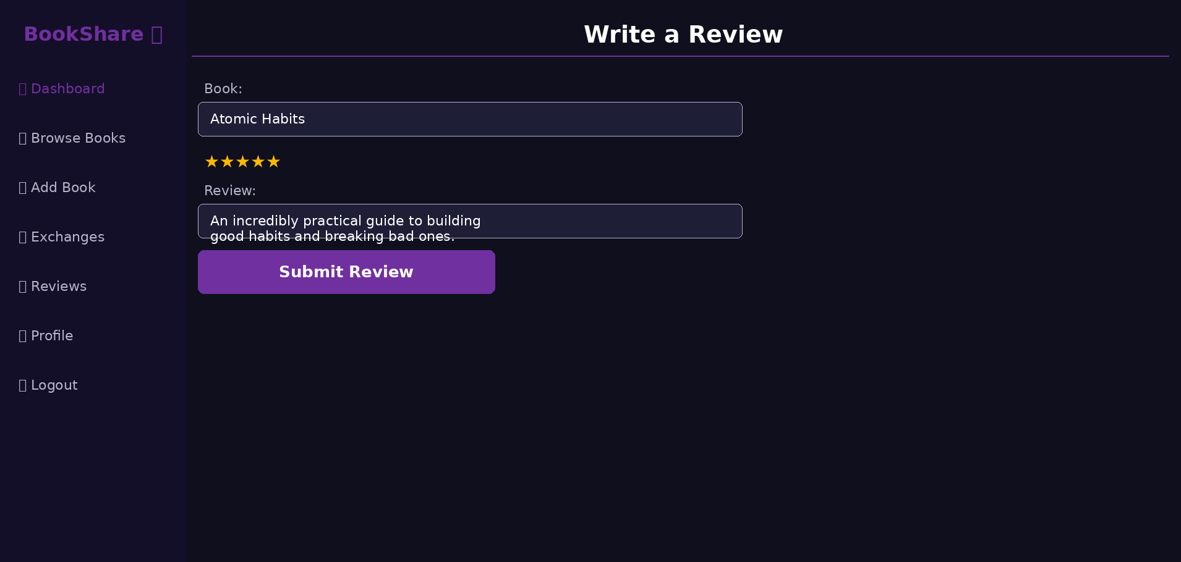

Slide 17
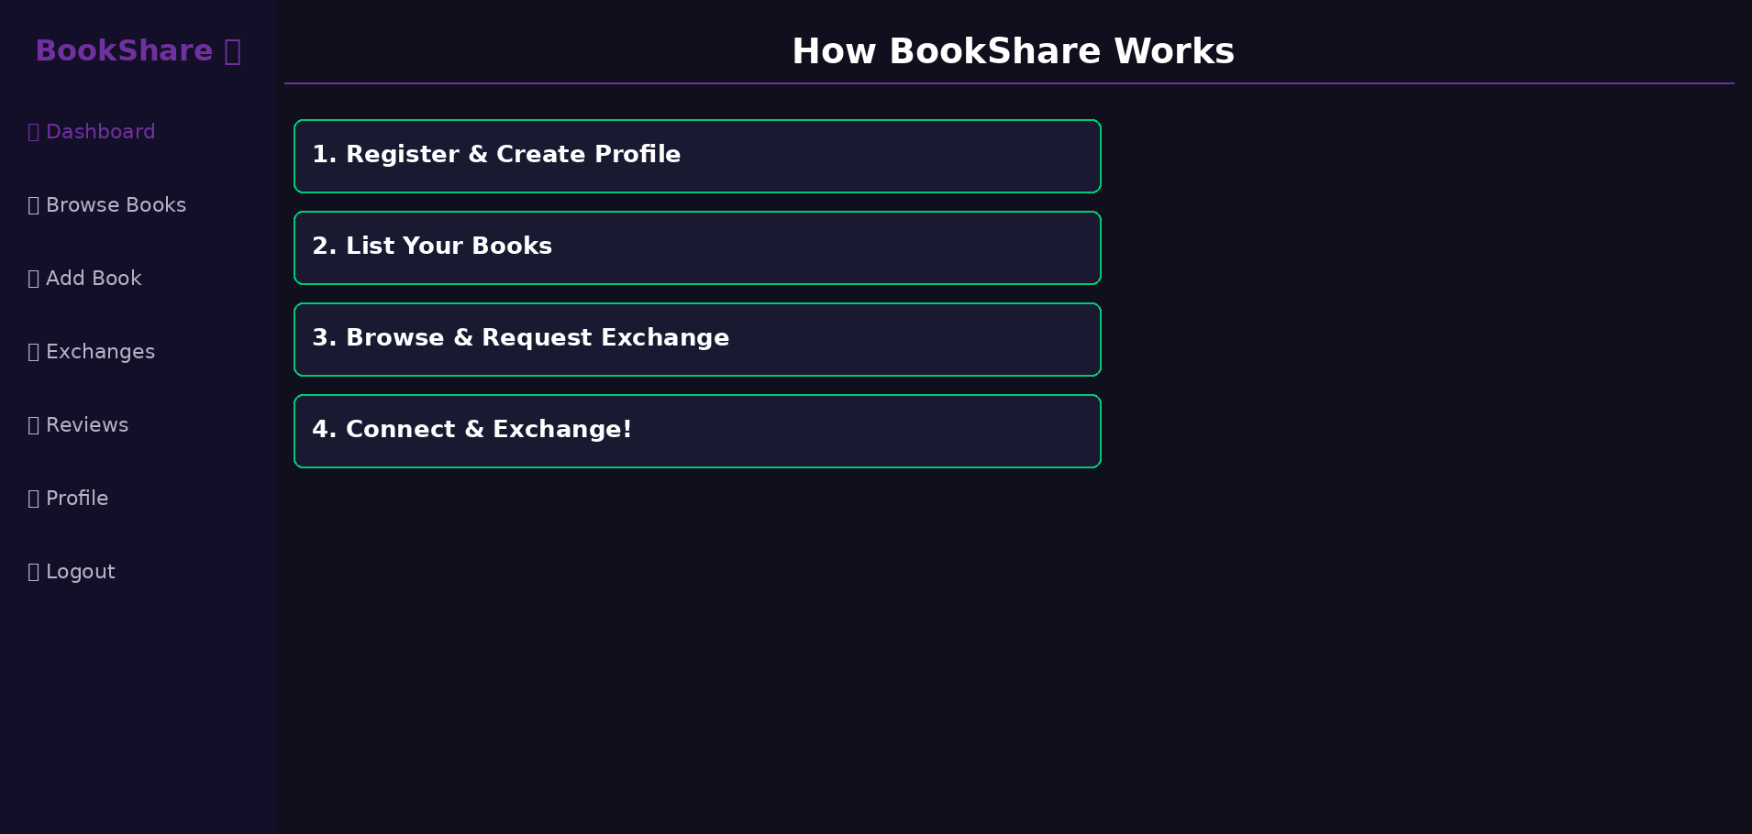

Slide 18
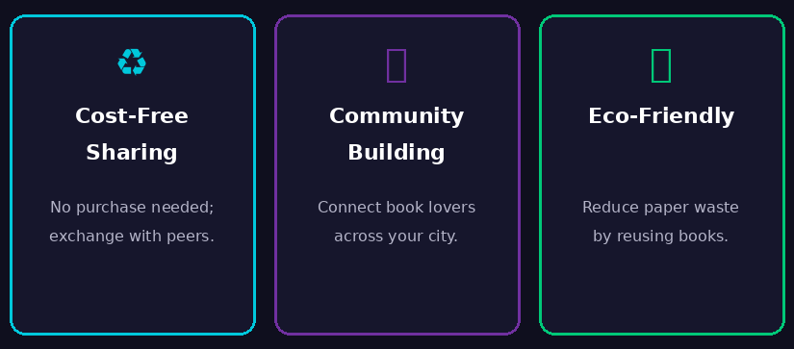

Slide 19
Advantages

Slide 20
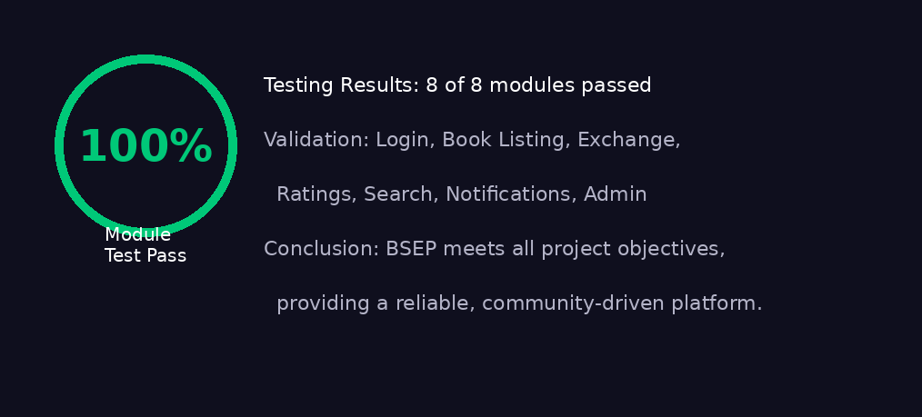
Results and Conclusion
• All modules of BSEP tested successfully.
• Platform is reliable and ready for community deployment.

Slide 21
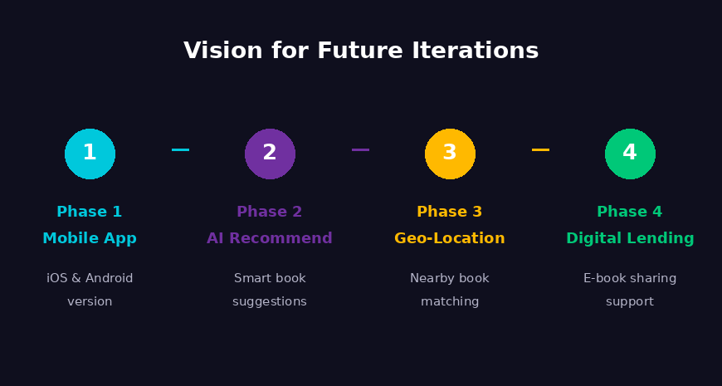
Future Enhancements
Mobile app version
AI-based book recommendations
Geo-location based matching
Digital book lending support

Slide 22
THANK YOU!!!

